Slide 1



Solar Disinfection of Greywater for Landscape and Edible Plant Use
Anna Gorman and Lar Reiboldt

Slide 2
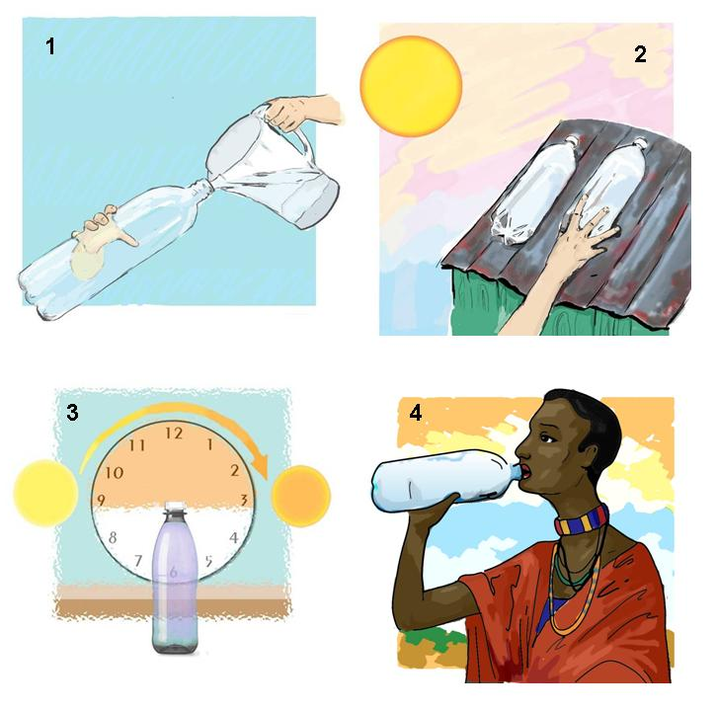
What is Solar Disinfection (SODIS)?
UV-A radiation and thermal treatment
Creates reactive forms of oxygen
Hydrogen peroxides
Oxygen free radicals
Destroys pathogens
Used in developing countries
Drinking water
6 - 48 hours
World Health Organization recommended
Cheap, simple, and successful

Slide 3
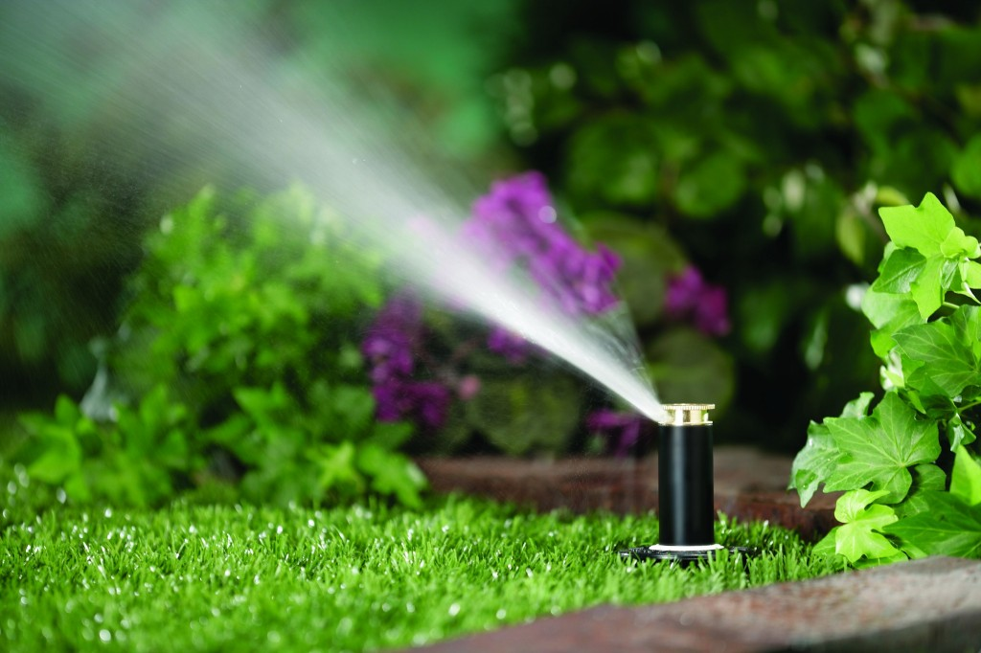
Applying SODIS to greywater
Shower, laundry, and wash basin
low nutrient content
Why disinfect greywater?
Water is a limited resource
Reduce potable water usage
Redirect water
Industrialized countries: 100 L/Person/Day
The single largest use of treated water in American cities is on the landscape
40-CFR requires that water used on edible plants comply with national drinking water regulations → No bacteria, nutrient limits
Notes:
The same process can be applied to greywater. The purpose of SODIS is to destroy pathogens and there are often pathogens present in greywater. Although greywater composition varies significantly based on household, country, and lifestyle.

Slide 4
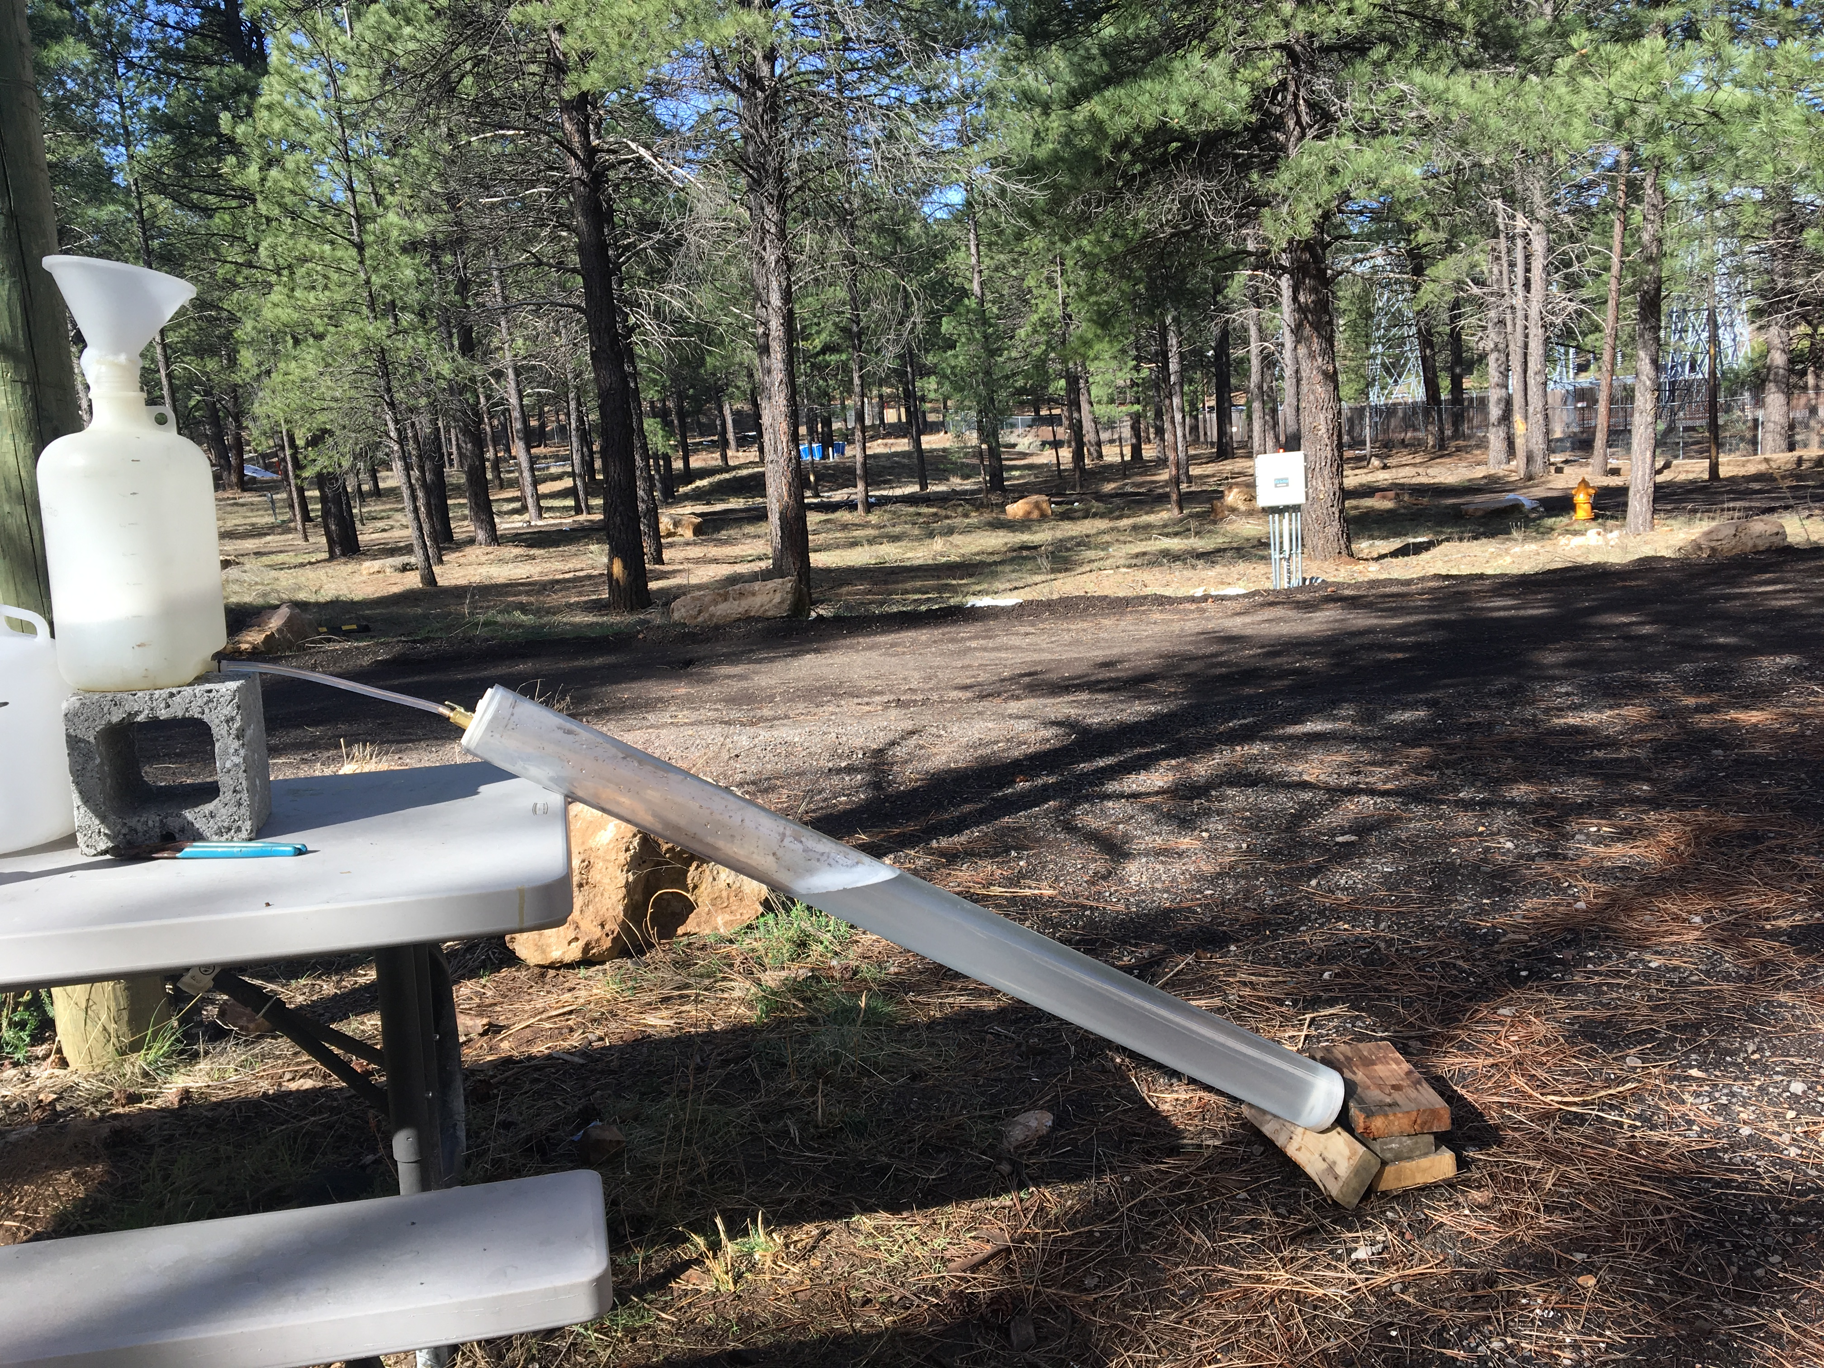
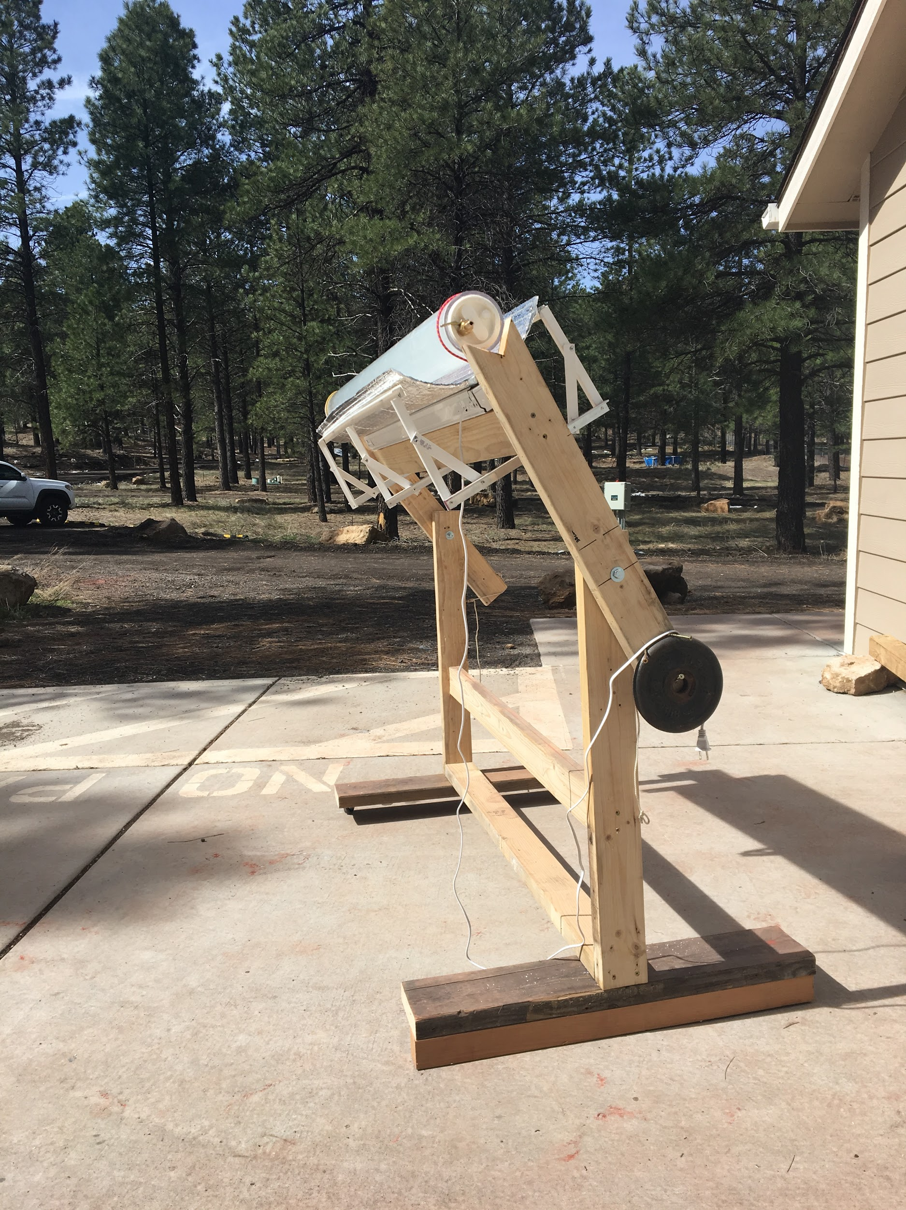
Project scope
SODIS method on synthetic greywater
Shampoo, toothpaste, nutrients etc.
Secondary effluent from Rio de Flag WWTP
Bench scale batch reactor
1/16 daily per person usage (6.25 L/P/D)
Manual inflow and outflow
Determine if water is drinkable, pathologically speaking
Test DO, pH, temperature, turbidity, e-coli
Backup UV-C light bulb
Creates a double bond between two Thymine molecules
± 35º latitude, focus on arid regions

Slide 5
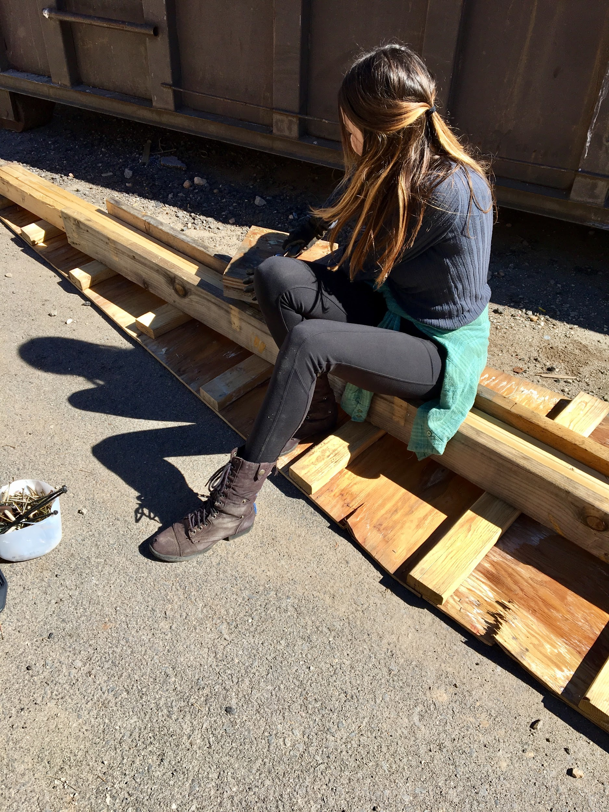
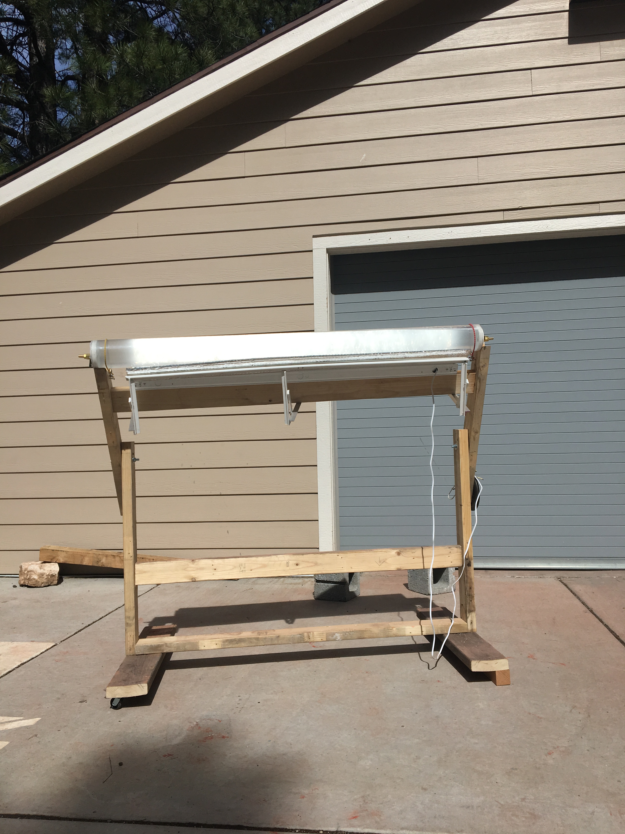
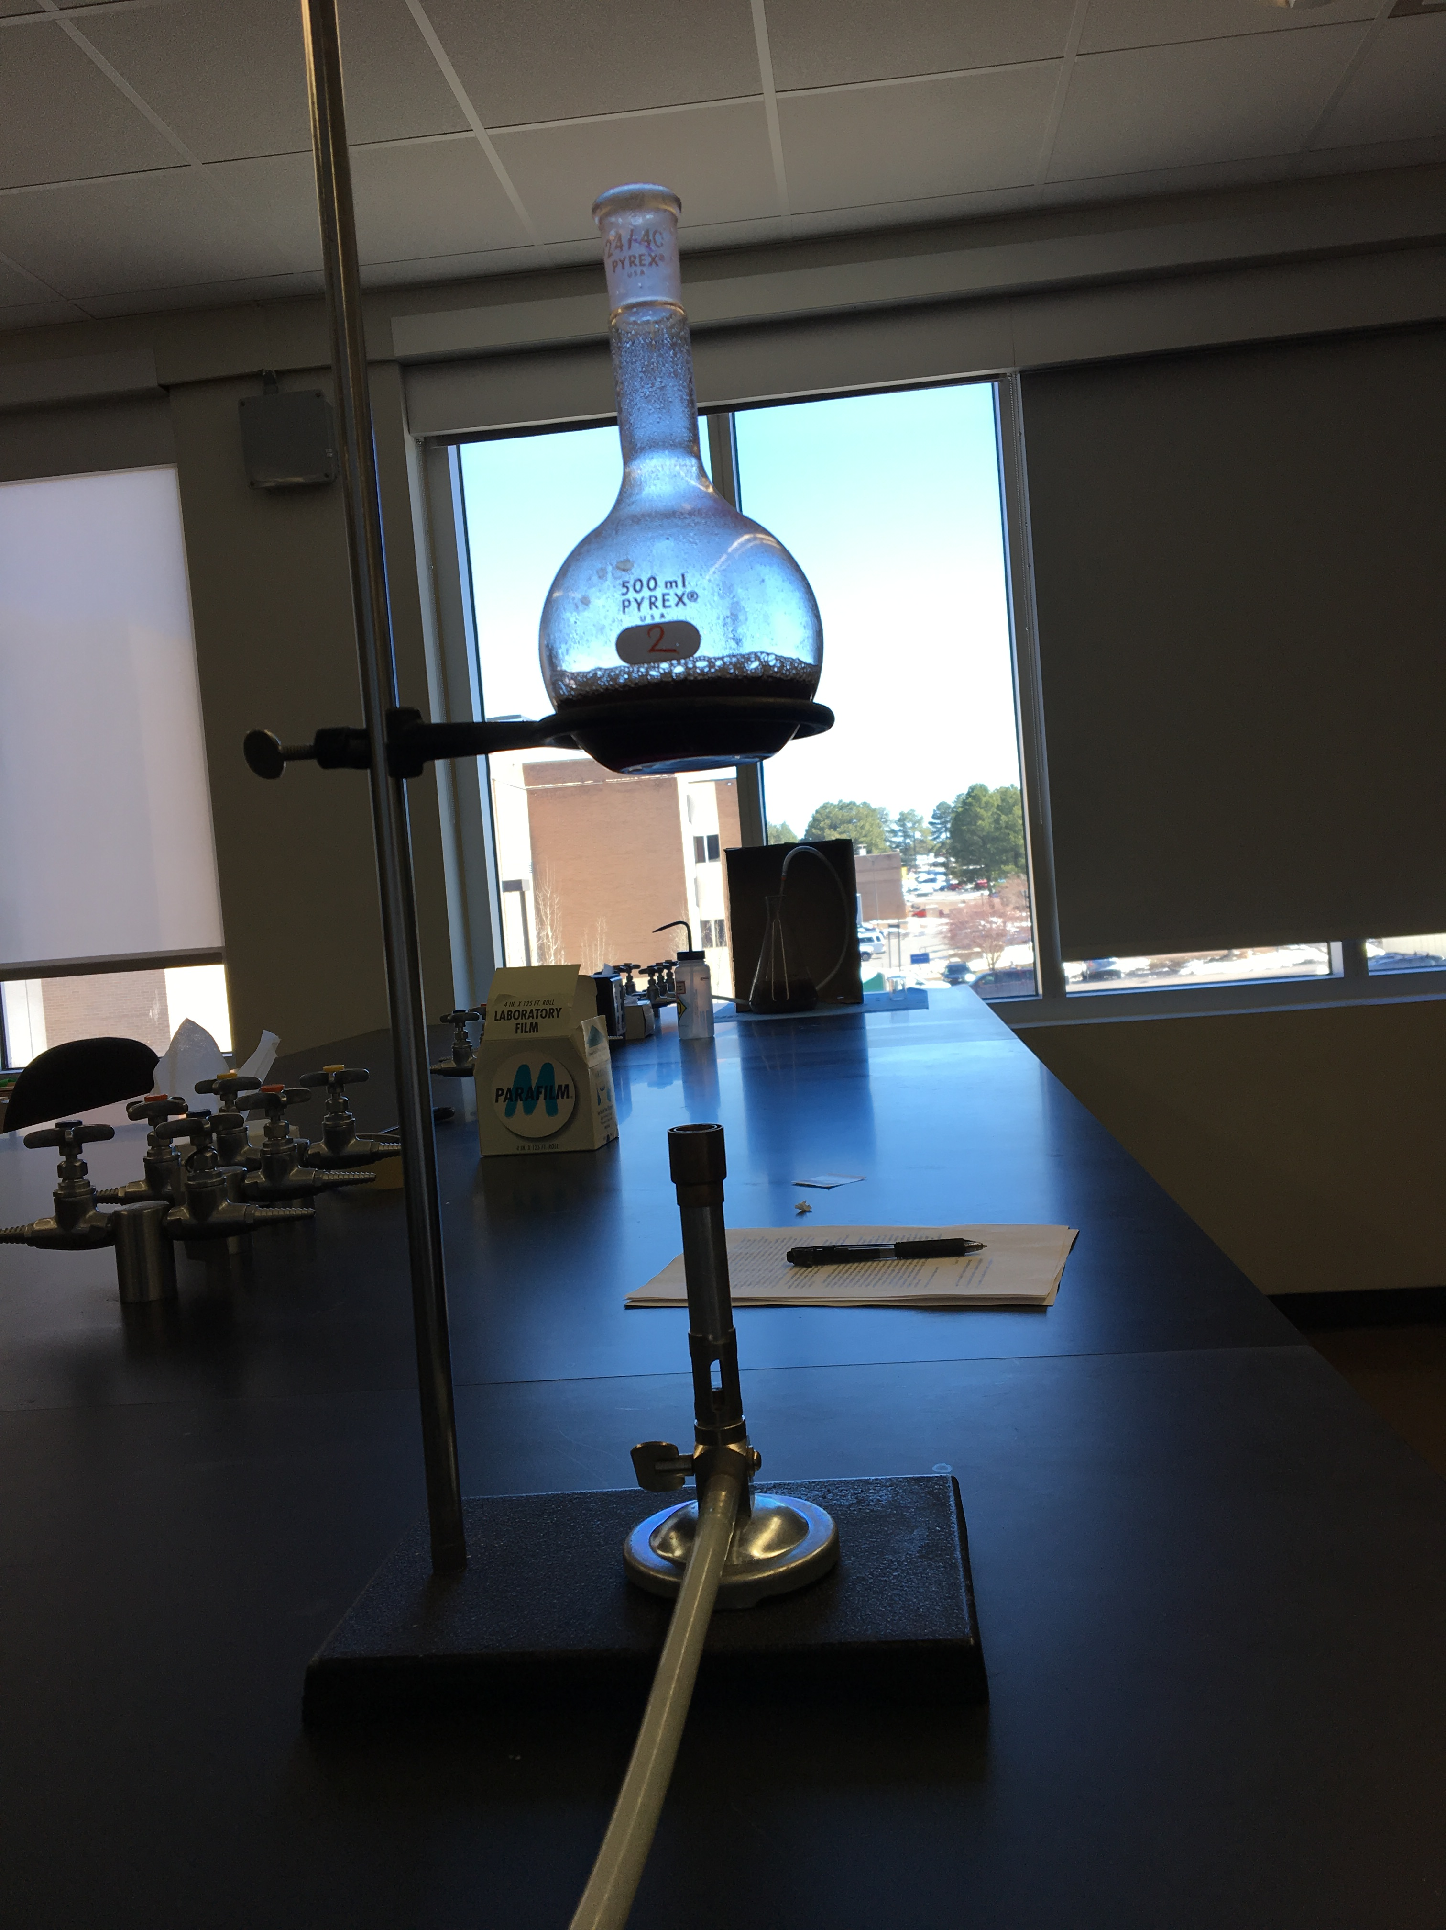
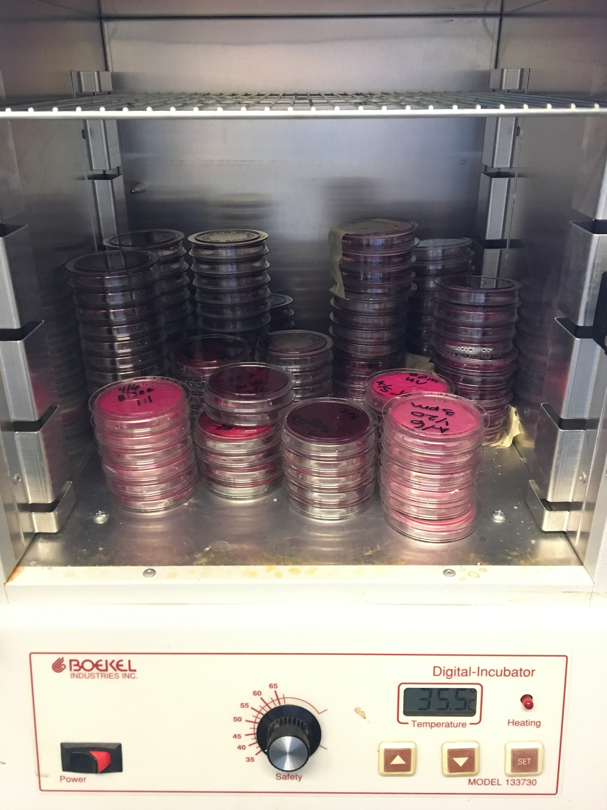
Application to NASA
NASA is interested in more than space
“We reach for new heights and reveal the unknown for the benefit of humankind”
Project depends on sun and water
Water fosters life
Sun reaches other planets in our solar system

Slide 6
Results
What didn’t work
What worked
Parameter | Average | % Difference Pre-Treatment | % Difference Post-treatment
Turbidity (NTU) | 15.90571429 | 12.71420873 | -2.173522544
pH | 6.977142857 | 0.442260442 | 2.448812449
DO (mg/L) | 5.788571429 | 14.67423495 | -9.960513327
Temperature (°C) | 22.50928571 | -6.945070288 | 3.281820201

Slide 7
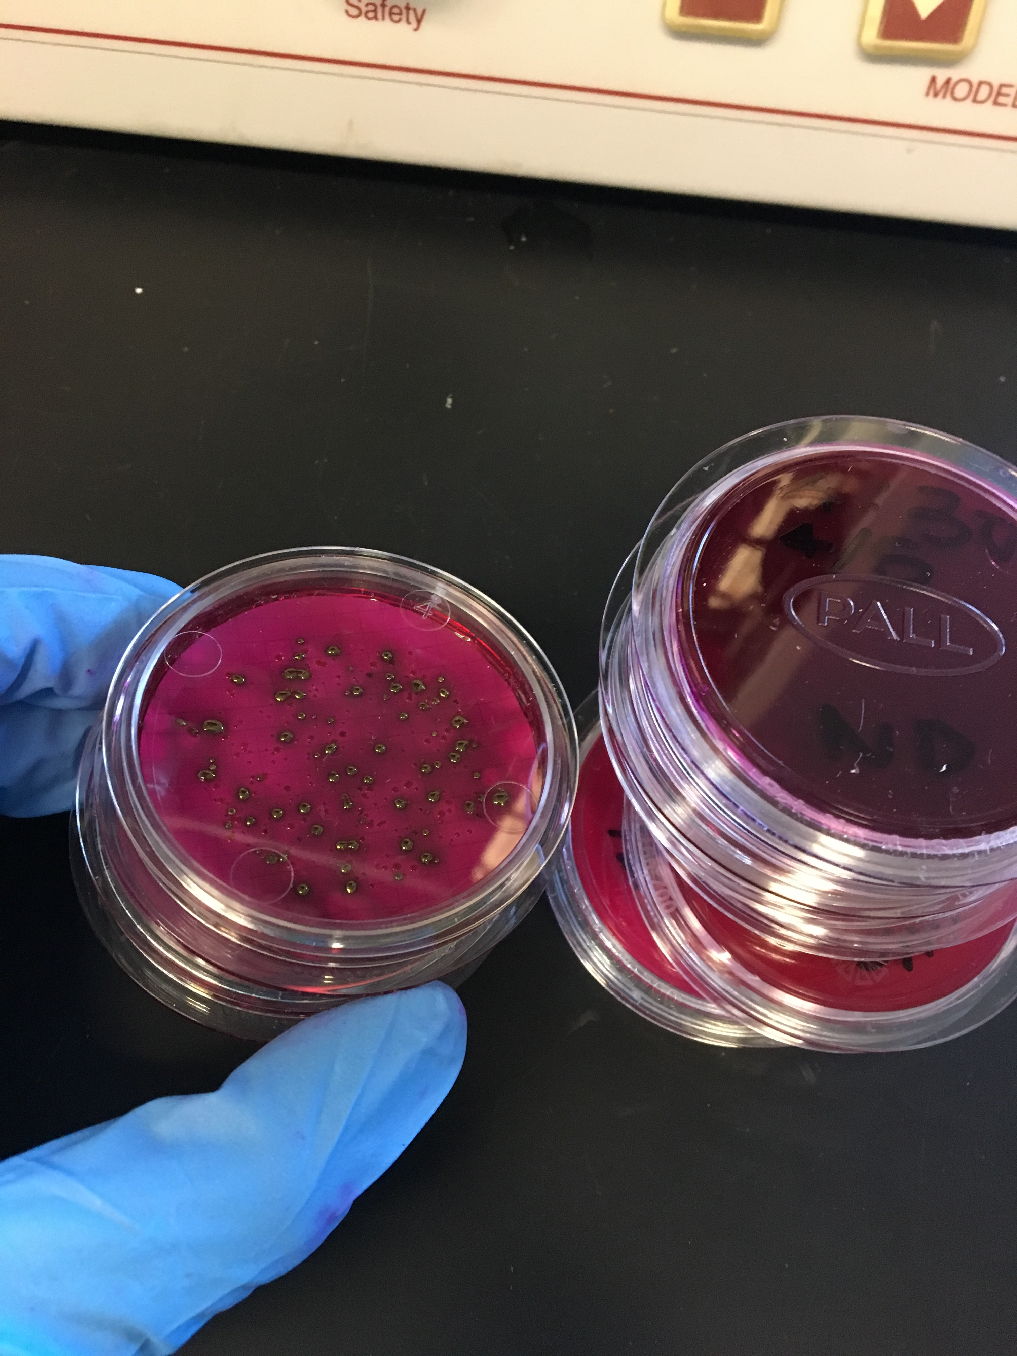
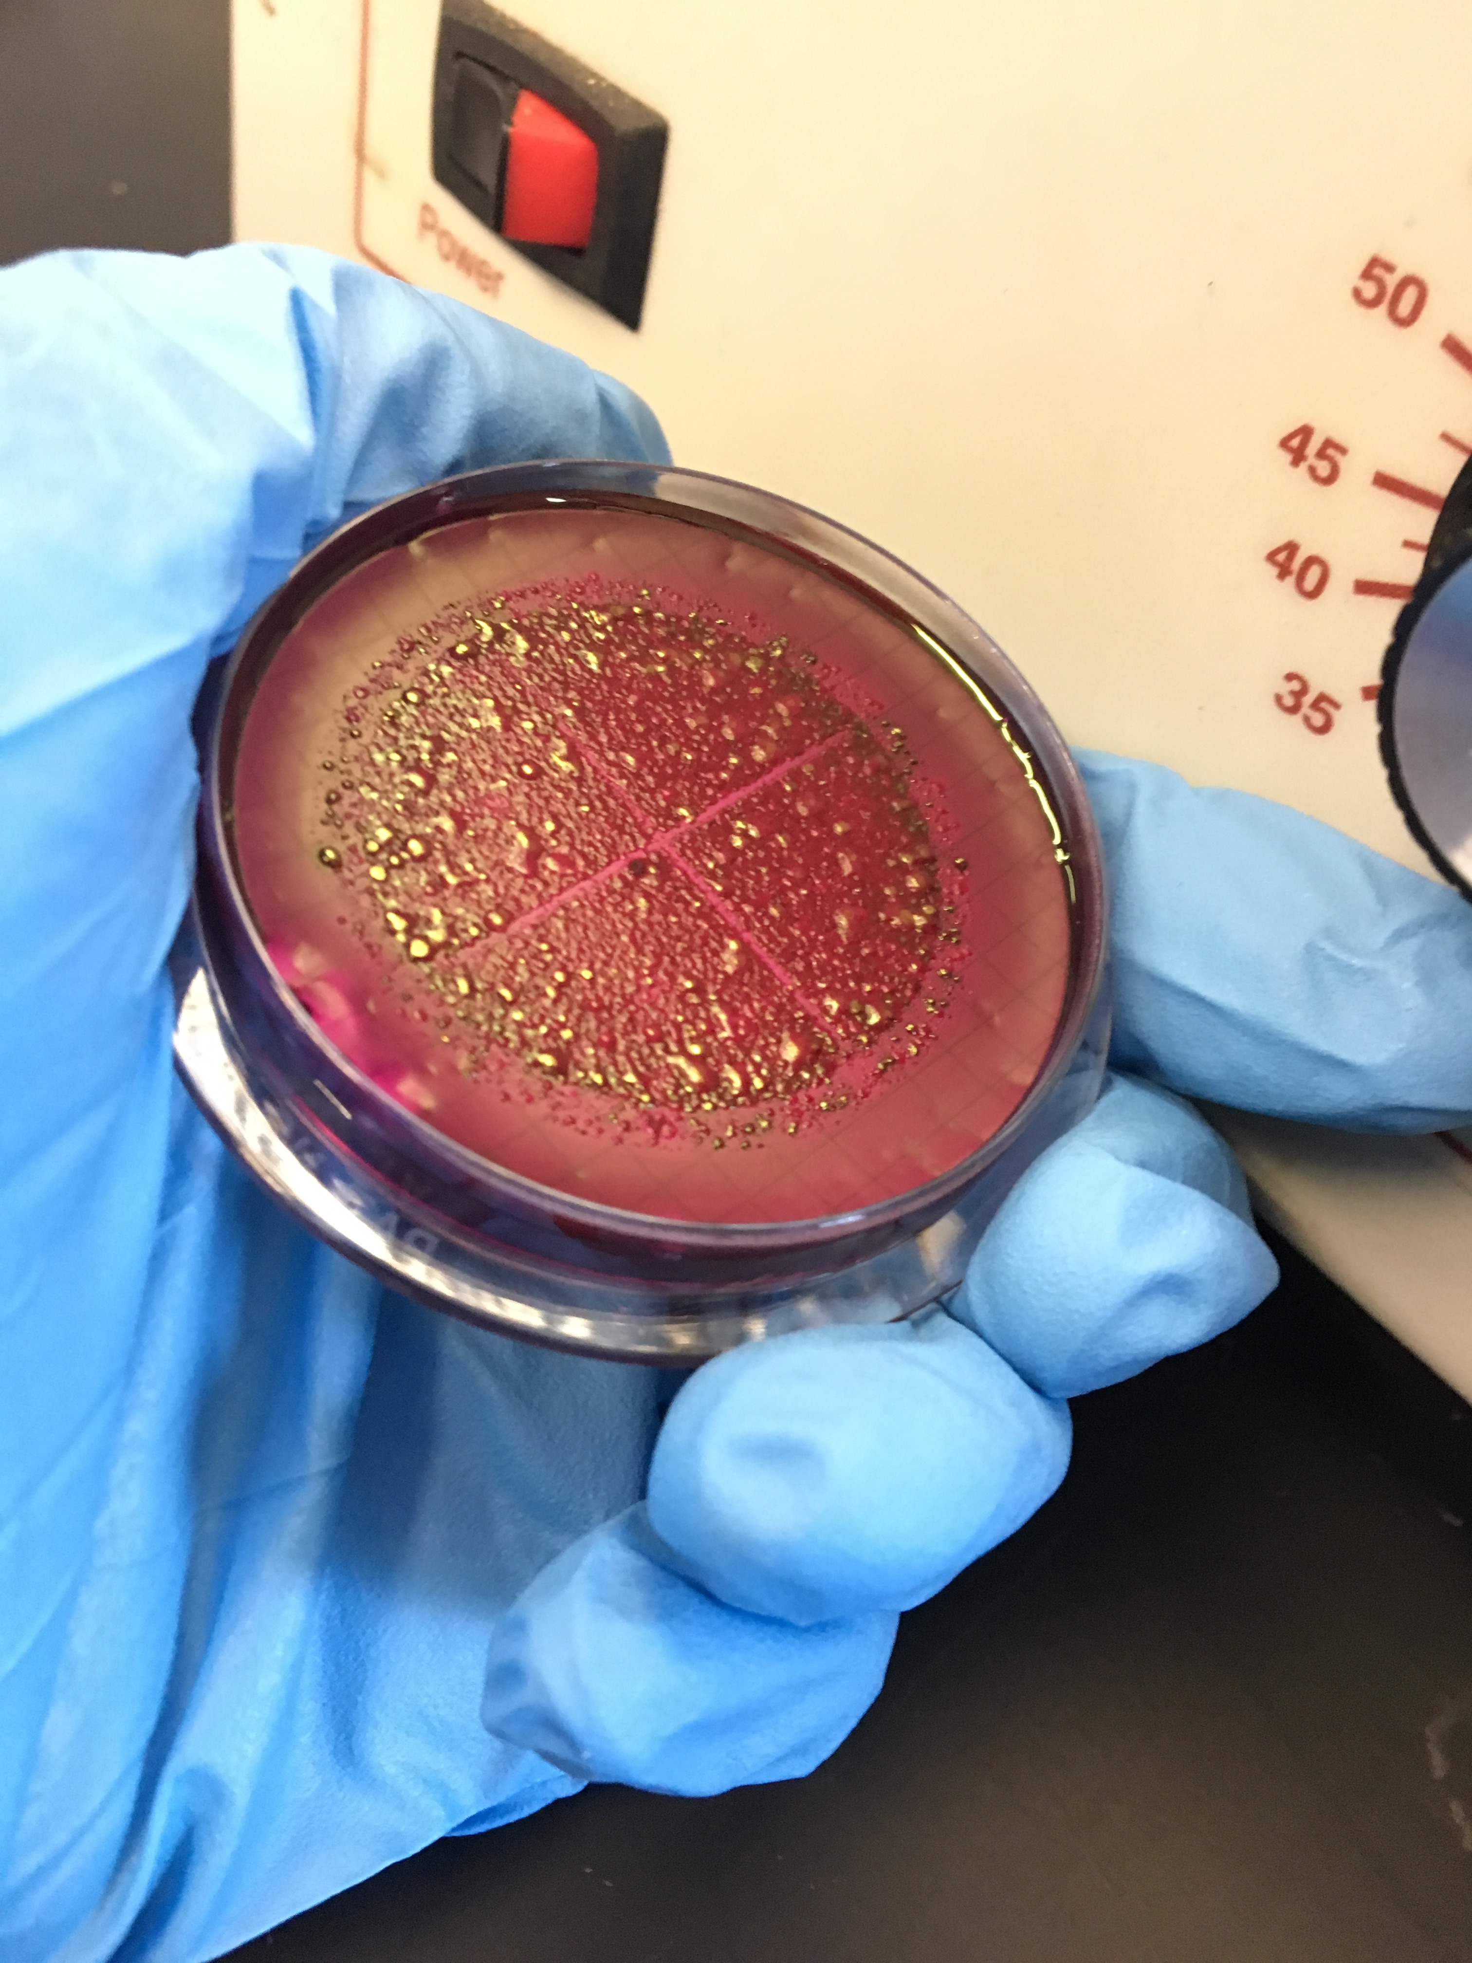
Sources of Error
Pulling sample from dead zone
Inadequate length of reflective surface
Shaded areas – clouds and trees
High turbidity levels
Type or thickness of plastic tube
Uncountable colonies (TNTC)
Cross contamination

Slide 8
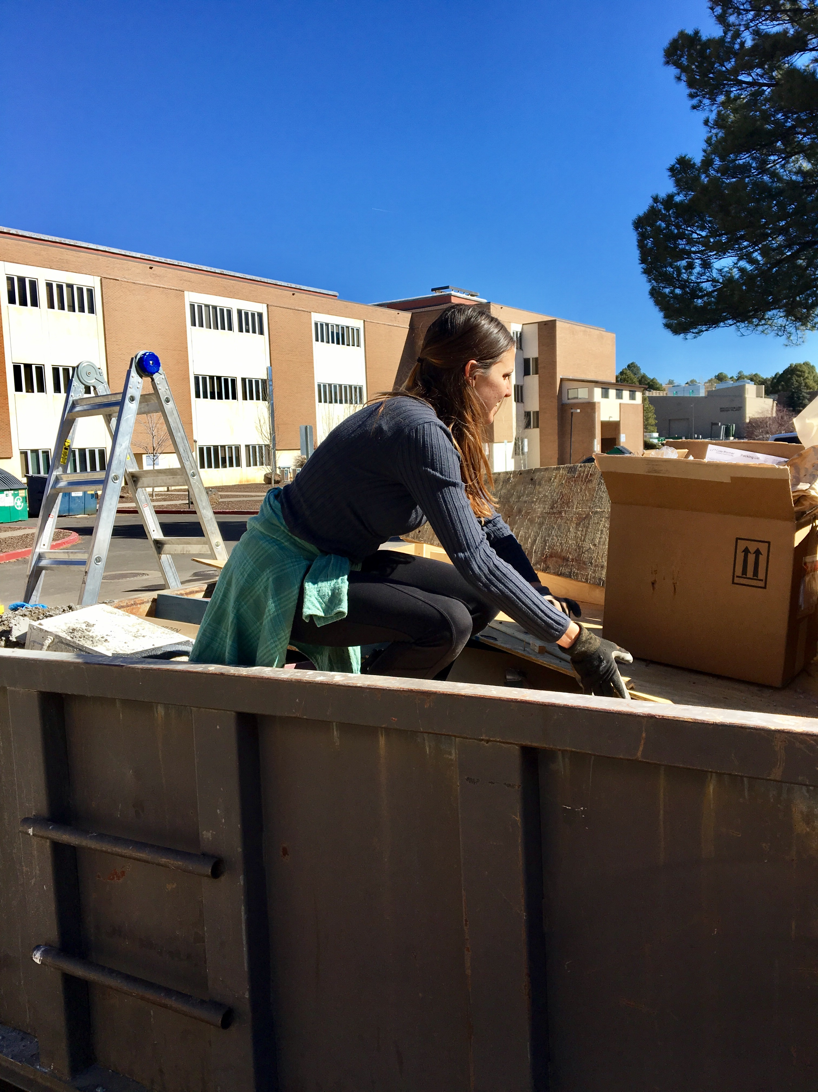
Future Work
Redesign unit / parameters
Replace plastic with glass or other material
Match lengths of reflective surface, UV light, and tube
Increase length of test
Test in warmer weather
Capstone Project

Slide 9
Acknowledgements
Lar Reiboldt, Mentor
Dr. Nadine Barlow, Director of NASA Space Grant at NAU
Kathleen Stigmon, Program Coordinator of NASA Space Grant at NAU

Slide 10
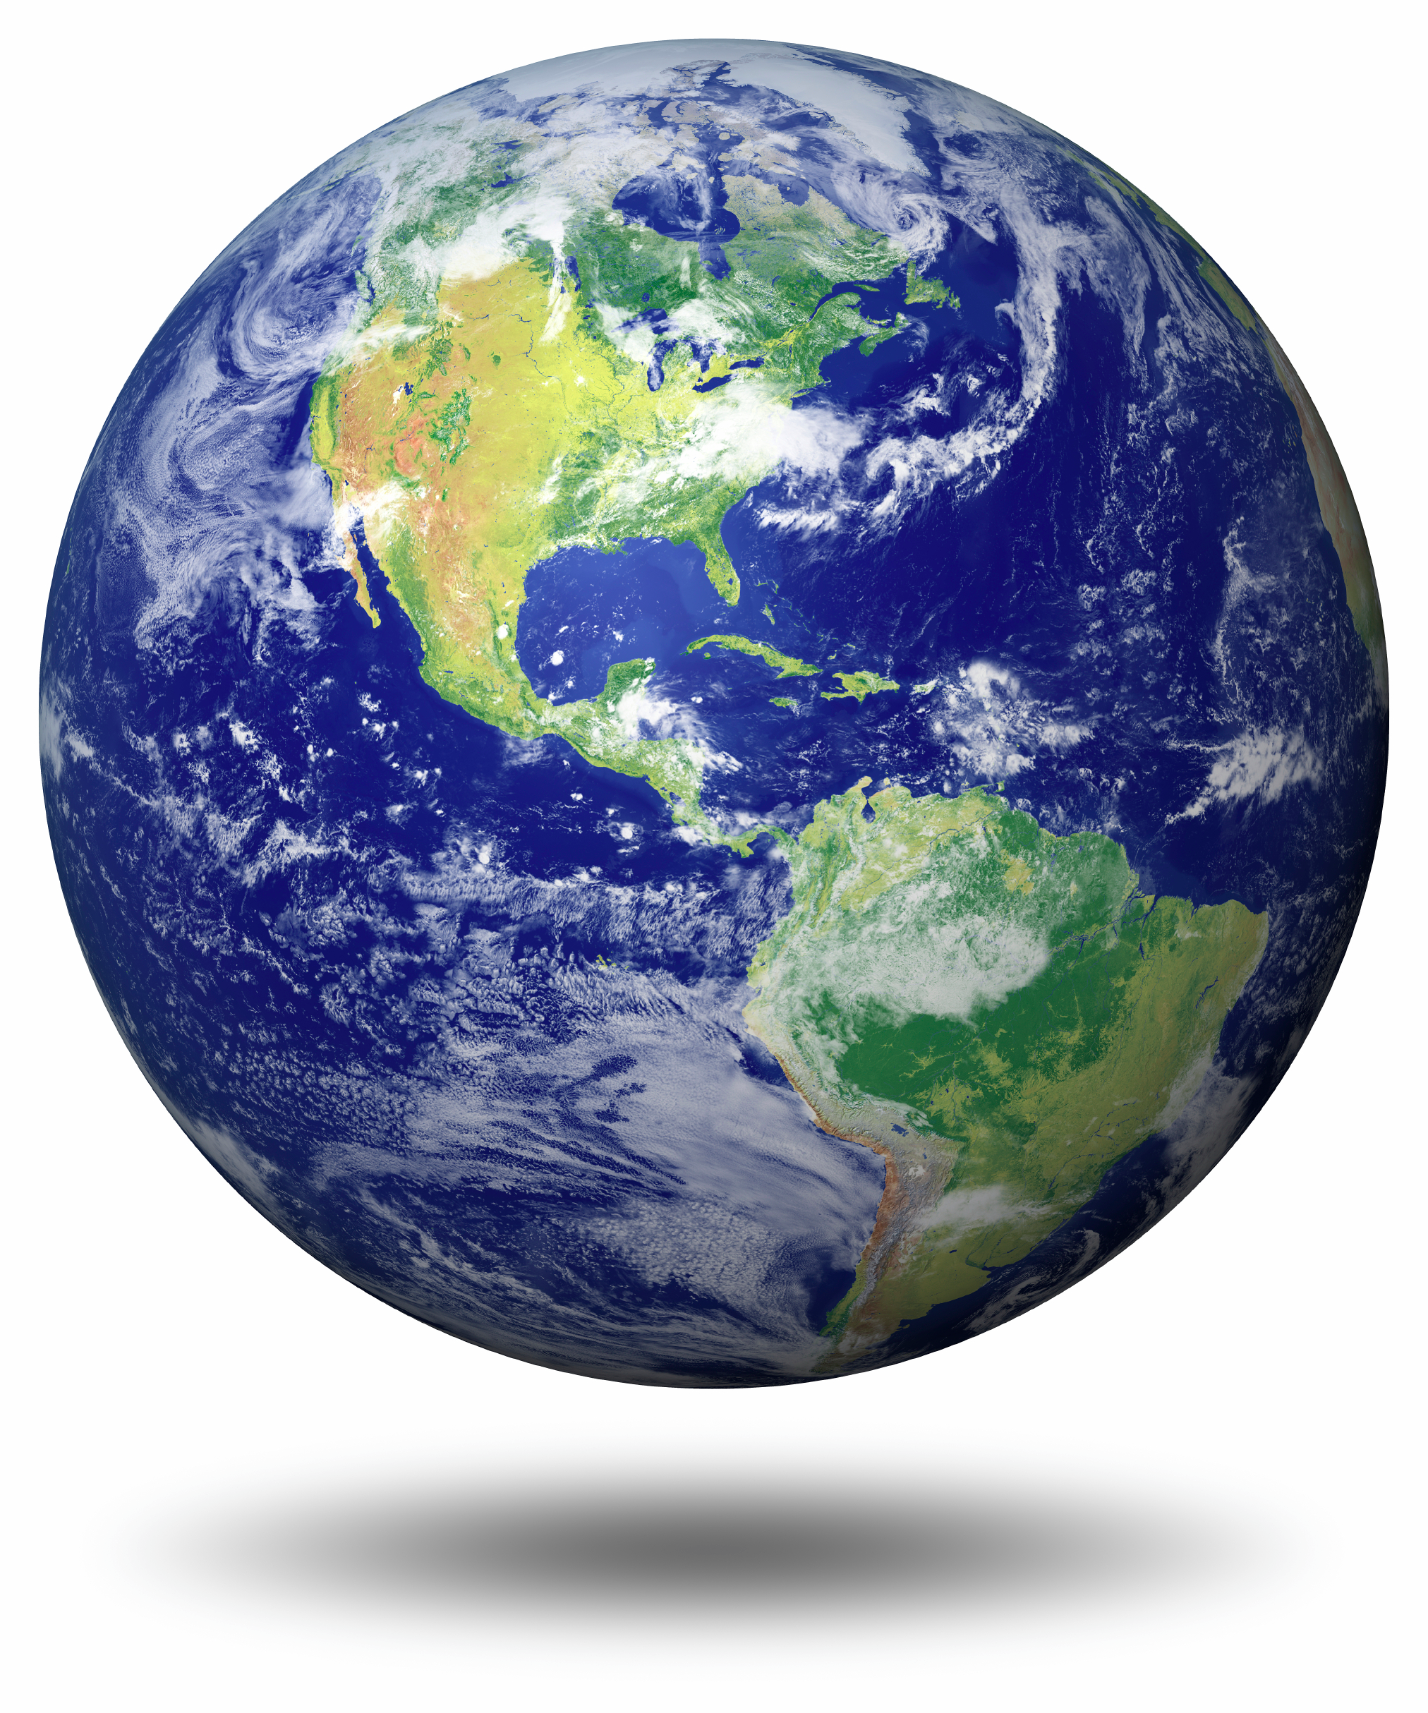
Questions?

Slide 11
References
[1] "Conserving Water." SRPWater.com. Salt River Project, 21 Feb. 2013. Web. 25 Feb. 2016.
[2] Meierhofer, Regula, and Martin Wegelin. "Solar Water Disinfection." Encyclopedia of Public Health (2002): 1321. Solar Water Disinfection. Swiss Federal Institute of Environmental Science and Technology, Oct. 2002. Web. 20 Feb. 2016.
[3] "World Health Organization." World Health Organization. N.p., 2016. Web. 22 Feb. 2016.
[4] "Department of Environmental Quality – Water Quality Standards." R18-9-711. Type 1 Reclaimed Water General Permit for Gray Water (2008): 1-77. Arizona Administrative Code. Arizona Public Services, 31 Dec. 2008. Web. 20 Feb. 2016.
[5] "Table of Regulated Drinking Water Contaminants." EPA. Environmental Protection Agency, 18 Feb. 2016. Web. 22 Feb. 2016.
[6] M. Terrazas-Onofre, "Solar Disinifection of Greywater," in Thai Society of Agrictultural Engineering, Bangkok, 2015.

Slide 12
References
[7] | A. Gross, A. Maimon, Y. Alfiya, E. Friedler, “Greywater Characteristics,” in Greywater Reuse, Boca Ratón, FL: CRC Press, 2015.
[8] | Department of Water Sanitation in Developing Countries (SANDEC), Solar Water Disinfection: A guide for the application of SODIS, Duebendorf : Swiss Federal Institute of Science and Technology, 2002, pp. 1-58.
[9] | U.S. Government Publishing Office, ECFR - Code of Federal Regulations, Washington D.C.: U.S. Government Publishing Office Bookstore, 2016.
[10] | C. Diaper, M. Toifl, M. V. Storey. “Greywater Technology Testing Protocol,” CSIRO, Australia, Rep. 1835-095X, 2008.
[11] | K. McGuigan, et al. “Solar Water Disinfection (SODIS): A review from bench-top to Roof-top,” J. Hazard. Mater., pp. 1-18, Aug, 2012.
[12] | J. Mosher, Ultraviolet Disinfection Guidelines, 3rd ed., Fountain Valley, CA: National Water Resource Institute, 2012, pp. 21-36.

